Slide 1
COVID &Leadership Sabine von Preyss-Friedman, MD, FACP, CMD Washington State Society for PA and LTC Medicine, President
Special Thanks to
David A. Nace, MD, MPH, CMD University of Pittsburgh
Dallas Nelson, MD, CMD University of Rochester

Slide 2
Objectives
Knowledgeable about
Attributes of an effective leader
Assemble your team to make decisions
How to communicate in a crisis
Specific Leadership Actions during COVID
Monoclonal Antibodies for COVID – Be a Leader

Slide 3
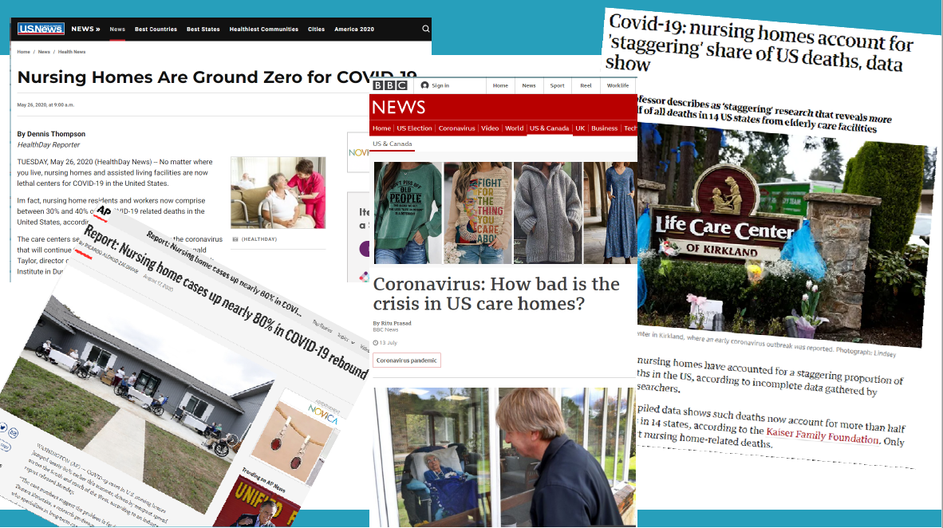

Slide 4
When COVID “hit”
Do you remember the Moment you heard about LCC Kirkland?
What was your first action?
Please enter in chat
Do you remember the moment of your first COVID patient?
Who did you call?
Why?
Please enter in chat

Slide 5
My Leadership Team
King County Crisis Response Team
Dr. Steve Mitchell
Company CEO
Adminstrator
Director
Of
Nursing
Medical Director
UW Medicine Infectious Disease Team
Dr. John Lynch
Legal Counsel
Caryn Marney

Slide 7
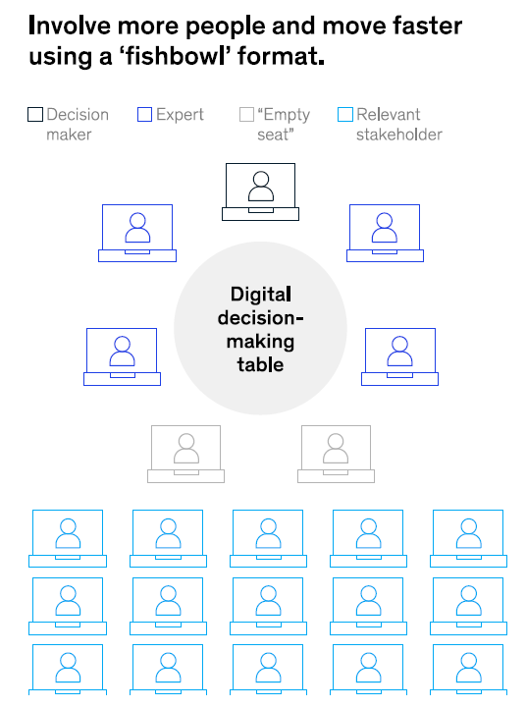
McKinsey, April 2020

Slide 14
David Farrell, LNHA, MSW
(510) 725-7409
djfarrell1963@yahoo.com

Slide 15
Creating the Right Conditions– Leadership Practices
Rounds
Words
Stories
Behaviors
Strategic Plan
Timing
Data
Listening
Notes
Huddles
Content
Timing
Predictability
Notes:
Here is a bundle of leadership best practices which my co-authors and I highlight in our second book.
This bundle includes – Leadership rounds , Leadership notes to staff, and Huddles
These three leadership best practices are mutually reinforcing, in that each one supports the other best practice within the bundle.
Implementing just one of the best practices, or two, is not as effective as implementing all three.
Visual leadership and strong communication are important right now. And this bundle addresses both of those organizational needs.
Leaders must create the right conditions to put their people at their best everyday during this crisis.
To do so – conduct effective rounds, keep staff informed through notes and hold regular huddles with the staff.

Slide 16
COVID-19 Huddles
Ensure everyone has the same information
Everyone can pitch in and work together
Everyone knows who tested positive or negative and who is on watch list
Everyone knows the interventions that work
Promote collaboration
Everyone’s input is received
Everyone is a part of problem-solving
Everyone knows they are valued
Notes:
The third best practice in this bundle is Huddles, which mutually reinforce the other two best practices.
Huddles with leaders and staff members are often facilitated by leaders during each shift.
They generally start at the same time, last 15-25 minutes, have an agenda, rules, and opportunities for frontline staff to inform the leaders what is working and what and who they are concerned about.
Many nursing homes have adopted huddles as an organizational practice to ensure –
Everyone has the same information
Everyone knows which residents we are all concerned about and should be watched closely
To promote teamwork

Slide 17
Five Key Questions to Ask When Making Rounds
Relationship building
“How is your family and how are your beautiful kids doing?”
Focus on the positive
“What is working well to keep everyone safe today?”
Positive feedback loop
“Is there anybody that you are working with who has gone above and beyond the call of duty today?”
QI – Infection Control
“Is there anything we can do better to keep the virus out today?”
Needs
“Do you have the PPE, enough coworkers and the right equipment to do your job well today?”
Notes:
Rounds start by asking the staff questions in order to build the relationship.
And even with the right PPE, research shows that healthcare workers are 3.5 times more likely to test positive for C19 than non-healthcare workers.
Rounds are not just about observations…they are about asking good questions…strategic questions…and connecting with staff…while reinforcing the key information shared in the huddle
Review

Slide 18
Rounds – What to Say and Do
Trigger higher performance -
Say - “I am worried about…I am proud about…thanks for helping her with that…that was nice of you…the residents really love you…I notice that you really care…thanks for being here today…I really like working with you”
Do – Answer call lights…hold doors open…sit in the break room… don the PPE and sit at the end of a residents bed and talk to them…carry a leftover food tray back to the kitchen…move a linen barrel to the right spot…slow down…go look everywhere…
Notes:
Leadership presence and visibility on the units and in resident rooms modeling proper infection control practices is key.
Communication during rounds allows you to catch your staff doing something right and let them know they have been caught.
Every hour, employees are committing acts of compassion and keeping people safe. Let them know you saw them and appreciate it.
Nothing is more important to creating a culture of excellence than rounds…Talking to your people and taking action based on what you hear.

Slide 19
Administrator Notes to Staff During COVID-19
Monday’s Note from the Administrator
Congratulations to Cynthia Poppens – May Employee of the Month! Also – Congratulations to Laurianne Niko – May Rookie of the Month! Both of these C.N.A.’s exemplify our core values and follow our strict infection control protocols to the letter. It’s an honor to work with both of you! You both stepped up and worked extra shifts during the outbreak. On behalf of everyone here – thank you!
Thanks you for accepting and wearing your new name badges with your pictures. By displaying your name and face the residents can read them and can help identify who you are. Don’t forget to always introduce yourself to the residents and coworkers.
It is Monday morning and I see great people here… who show up… everyday… follow our strict infection control guidelines… we are so proud of all of you!
Our commitment to widespread testing and our data reflects that we are starting to turn the tide! Both the positivity rate and total positive cases are declining. I am starting to feel more optimistic and you should too!
I continue to proudly serve as your Administrator. If you need anything, please come and see me, call my cell phone or send me an email. Thank you for all that you are doing to enhance our residents’ lives during these challenging times!
Sincerely,
David Farrell, Administrator
510-725-7409
Notes:
The next best practice in the bundle is about your written communication to your staff – or notes from the Administrator
Either through email lists and/or written notes similar to the one you see here,
Written communication is extremely important right now as we attempt to keep everyone informed regarding the latest updates from federal and state authorities and our organizational changes in response
Notes are highly effective in conveying key messages, data and facts.
Fear produces rumors but when leaders commit to using written communication tools like this one help to quell the fear and stop the spread of untruths, staff feel relieved and are more likely to come to work.
One to two notes a week are necessary right now in order to reinforce messages and clarify changing mandates.

Slide 20
Elements of a Good Note
Informative
Complimentary
Standard setting
Update on PIPs
Point out positive trends
Staffing changes
Sincere

Slide 21
Take Time to Write Some Thanks You Cards
Cards are powerful motivators
Birthday cards
Anniversary cards
Excellent attendance
Infection control champion!
“I appreciate you”
“I am glad you work for us. On behalf of the residents, their families and your co-workers – Thank you.”
Mail to their home address
Notes:
Thank You Cards are a powerful way to reinforce positive behavior
Good leaders are taking the time to formally thank their people with a good old fashion thank you card
Send the cards to their homes. This sends a powerful message to their families that their place of work is proud of them. Their families knowledge reinforces the positive feeling that comes from praise.
So send b-day cards, anniversary cards, congratulations and condolences. Get to know your staff as people and you will learn what's going on in their lives which is significant.
Cards say, “I care about you.”
At Department head meetings, pass out blank cards and have them write them during the meeting. Then mail them and 10 –12 will go out that day.

Slide 22
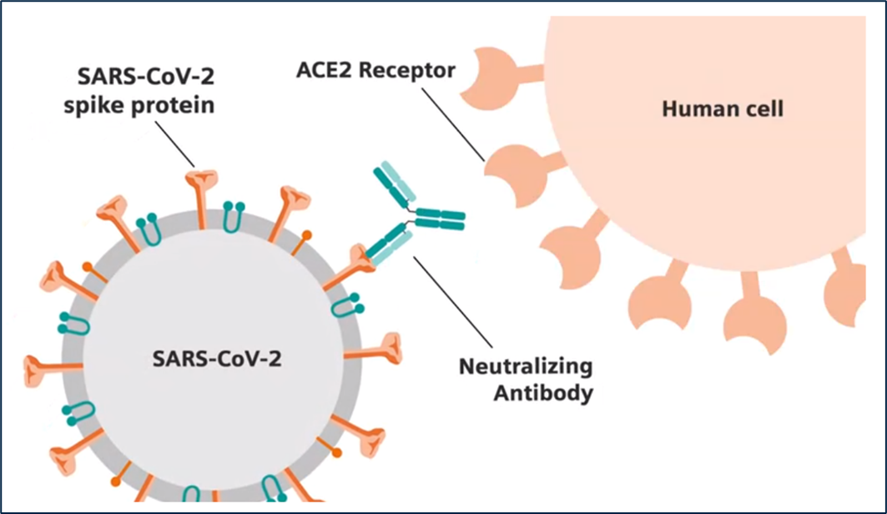
Monoclonal Antibodies
MAB block binding of the spike protein to the receptor
MAB = monoclonal antibody
Notes:
Defense analogy

Slide 23
Why Use Monoclonal Antibodies?
The FDA granted emergency use authorization for use for two MAB products in November 2020 and a third on 2/9/21.
Bamlanivimab (Eli Lilly)
Casirivimab and imdevimab (Regeneron)
Bamlaniviab and Etesevimab
Notes:
We are going to focus only on adults for this presentation.
Serologic tests do not count (antibody tests)

Slide 24
What are the Benefits?
Based on preliminary studies*
Reduced progression to severe disease
Reduced risk of hospitalization/ED visits
Reduced viral load
Reduced death rate
Notes:
Lilly PYAB = 465 subjects in the EUA for clinical efficacy
Regeneron 2067 = 799 subjects in the EUA for clinical efficacy
Reduced viral load may mean less risk of spread

Slide 25
Who Is High Risk?
Are ≥65 years of age
Are ≥55 years of age AND have
cardiovascular disease, OR
hypertension, OR
chronic obstructive pulmonary disease/other chronic respiratory disease
Body mass index (BMI) ≥35
Chronic kidney disease
Diabetes
Immunosuppression due to disease or treatment

Slide 26
Who Should Not Receive Monoclonal Antibodies?
Individuals who are hospitalized due to COVID-19
Individuals who require oxygen therapy due to COVID-19
Individuals who require an increase in baseline oxygen flow due to COVID-19 in those on chronic oxygen therapy due to underlying health conditions

Slide 27
Administration
IV infusion
Mixed in 0.9% saline
Infuse over 16 – 21 minutes
Can infuse with or without a pump
Use a filtered line
1hour post-infusion observation period

Slide 28
State of WA and mAB facilitation
The federal government is sending Washington State a monoclonal antibody product to the Department of Health (DOH). The DOH can distribute it to skilled nursing facilities that are interested in receiving the product free of charge.
Several SNFs in Washington have successfully infused residents already
WA-PALTC, WHCA and other interested LTC stakeholders have been involved in a workgroup with DSHS and DOH to increase the availability and resources needed for SNF providers to administrator this medication to those COVID positive residents that meet the criteria.
An intervention identified to assist the facility with the infusion of monoclonal antibodies is the use of the DSHS Rapid Response Staffing Support teams to “back fill” facility staff to allocate staff time. A number of example policies and protocols have also been developed to assist a facility in the administration of monoclonal antibodies.

Slide 29
My Leadership Team for mAB
Department of Health
Jennifer Dixon
jennifer.dixon@doh.wa.gov
P/P and Info:
WA-PALTC, WHCA &Leading Age
Adminstrator
Director
Of
Nursing
Medical Director
RCS: Rapid Response Teams
Your Pharmacy
Order sets
Delivery
P/P

Slide 30
Summary
Knowledgeable about
Attributes of an effective leader
Assemble your team to make decisions
How to communicate in a crisis
Specific Leadership Actions during COVID
Monoclonal Antibodies for COVID – Be a Leader

Slide 31
Sabine v. Preyss-Friedman MD, CMD
svpf1@comcast.net
(206) 226-9597
www.wapa-ltc.com

